Slide 1
REGRESSION
Linear Regression

Slide 2
Linear Regression
Linear Regression is a machine learning algorithm based on supervised learning. It performs a regression task.
Regression models a target prediction value based on independent variables.
It is mostly used for finding out the relationship between variables and forecasting.

Slide 3
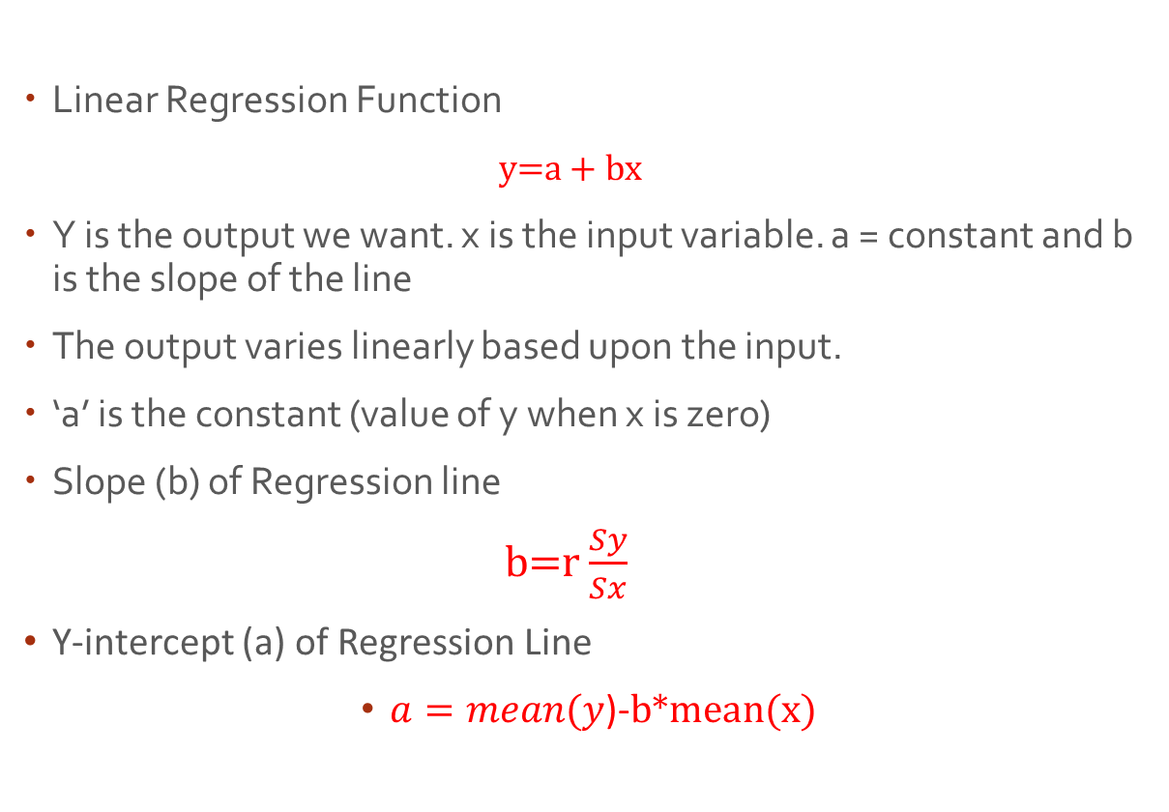
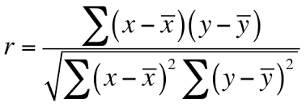
Linear Regression

Slide 4
Example
Student | x_{i} | y_{i} | (x_{i}-x) | (y_{i}-y)
1 | 95 | 85 | 17 | 8
2 | 85 | 95 | 7 | 18
3 | 80 | 70 | 2 | -7
4 | 70 | 65 | -8 | -12
5 | 60 | 70 | -18 | -7
Sum | 390 | 385
Mean | 78 | 77

Slide 5
Example……
And for each student, we also need to compute the squares of the deviation scores
Student | x_{i} | y_{i} | (x_{i}-x)² | (y_{i}-y)²
1 | 95 | 85 | 289 | 64
2 | 85 | 95 | 49 | 324
3 | 80 | 70 | 4 | 49
4 | 70 | 65 | 64 | 144
5 | 60 | 70 | 324 | 49
Sum | 390 | 385 | 730 | 630
Mean | 78 | 77

Slide 6
Example…..
And finally, for each student, we need to compute the product of the deviation scores.
Student | x_{i} | y_{i} | (x_{i}-x)(y_{i}-y)
1 | 95 | 85 | 136
2 | 85 | 95 | 126
3 | 80 | 70 | -14
4 | 70 | 65 | 96
5 | 60 | 70 | 126
Sum | 390 | 385 | 470
Mean | 78 | 77

Slide 7
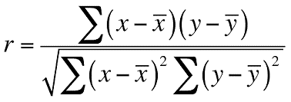
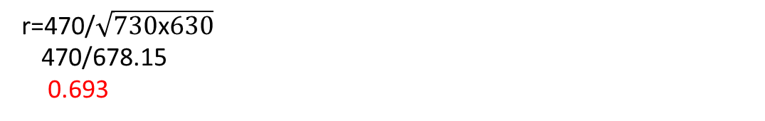
Slope…..
Pearson correlation coefficient
Compute the standard deviation of x (σ_{x/ Sx}):
σ_{x} = sqrt [ Σ ( x_{i} - x )² / N-1 ]
σ_{x} = sqrt( 730/4 ) = sqrt(182.5) = 13.5
Next, we find the standard deviation of y, (σ_{y /Sy}):
σ_{y} = sqrt [ Σ ( y_{i} - y )² / N-1 ]
σ_{y} = sqrt( 630/4 ) = sqrt(157.5) = 12. 5

Slide 8
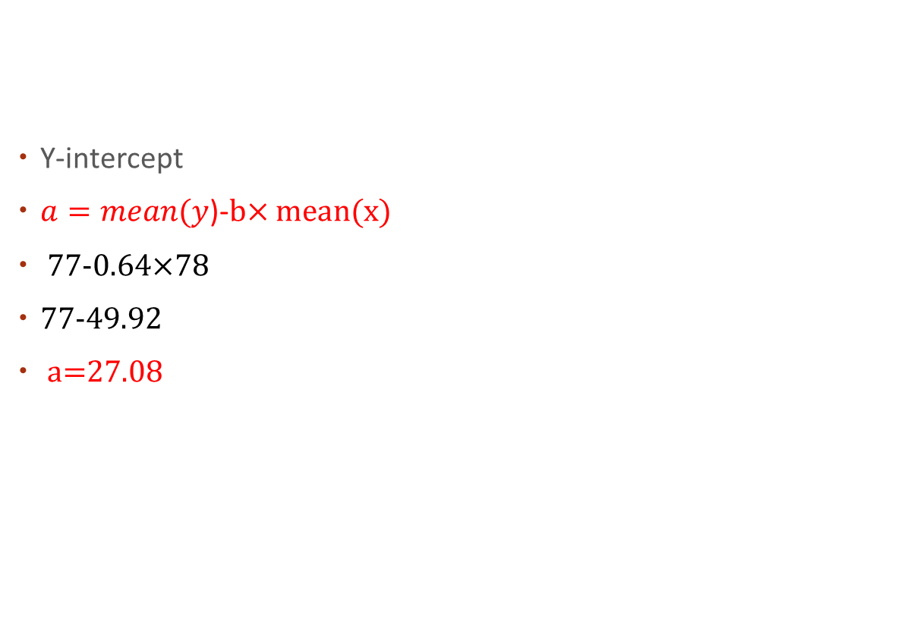
Y-intercept

Slide 9
Linear Regression Function
Linear Regression Function
y=a + bx
y=27.08+0.641(x)
If a student made an 80 in Intro to Programming, the estimated statistics grade (y) would be:
y=27.08+ 0.641(80)
=27.08+51.28
= 78.36

Slide 10
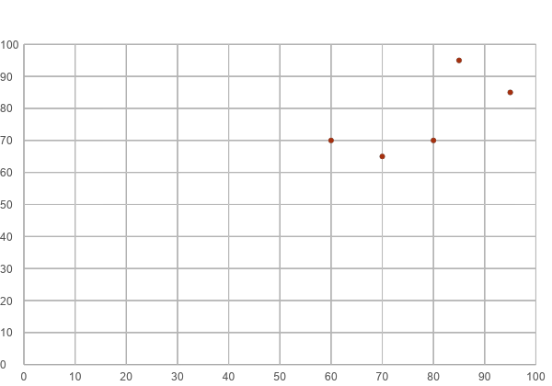
Linear Regression Graph

